Slide 1
Network-CZM
Jianming Zeng

Slide 2
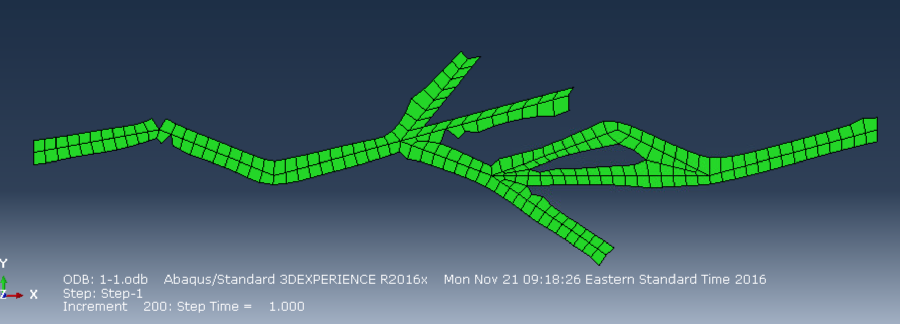
Current Success
1. Tree
2. Into several sub cracks
3. Join sub cracks back together

Slide 3
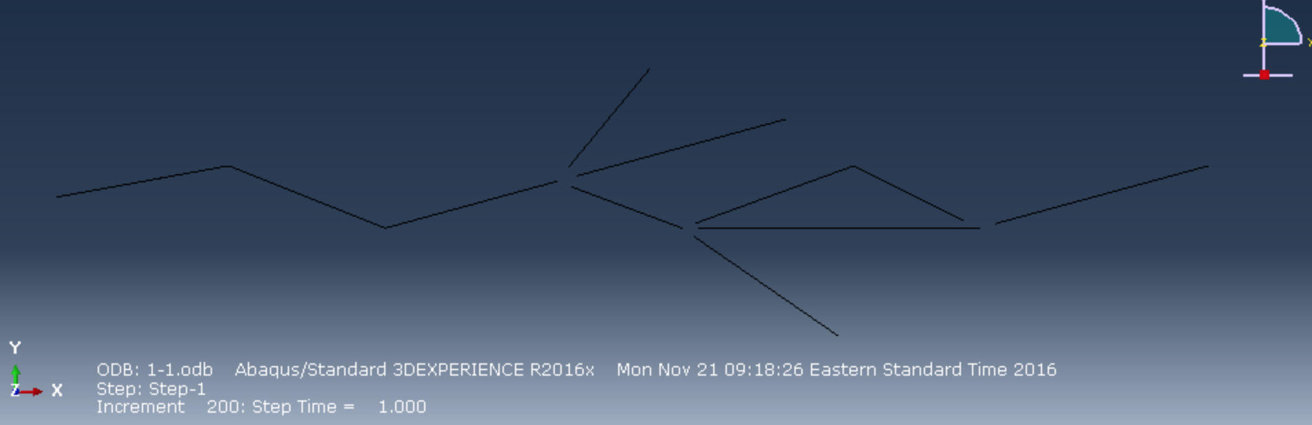

Slide 4
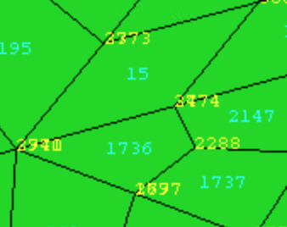
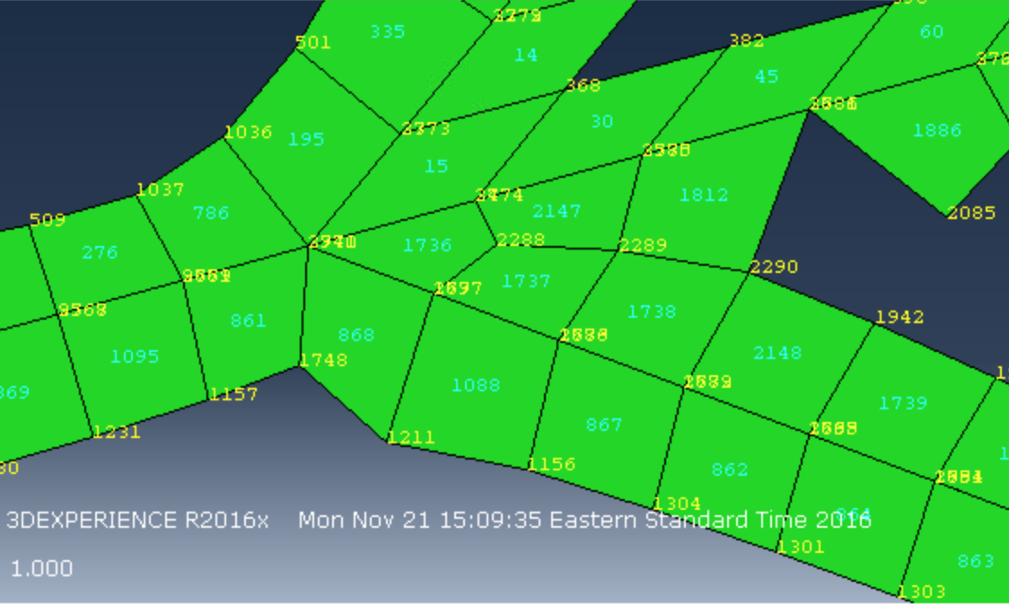
Things to considered when joining
1. Update the peripheral node number first

